Slide 1
Companion File Browser
Team Name: SDDEC19-11
Client: Kirit Chandran
Adviser: Dr. Zheng
https://sddec19-11.sd.ece.iastate.edu
Notes:
Luke

Slide 2
Project Plan
Notes:
Luke

Slide 3
Project Plan
Problem Statement
Buildertrend wants a new sub-system extension for their current software product which is a web application
Cloud file sharing system that allows users to sync and download files on the cloud
Provide users easy collaborations, error recovery, and high accessibility
Notes:
Luke

Slide 4
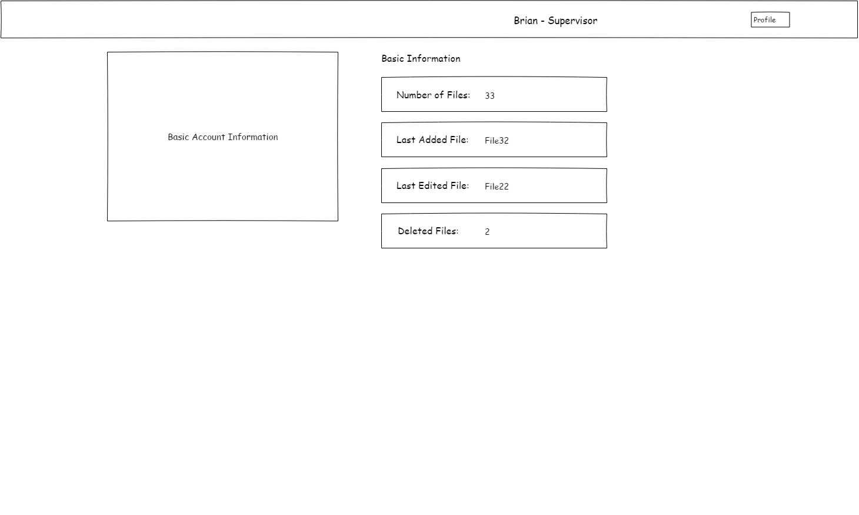
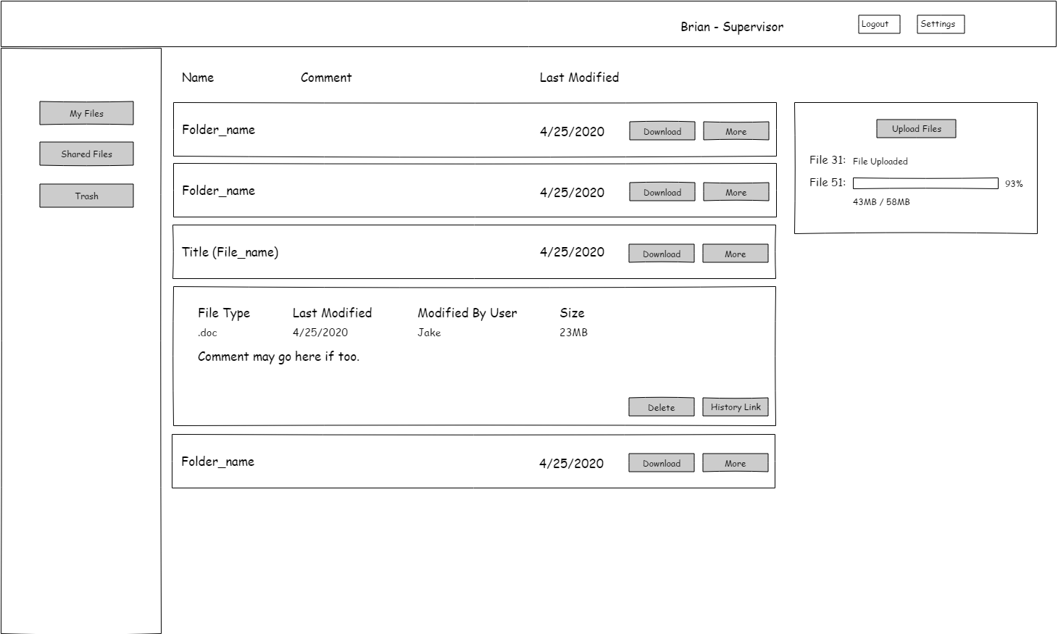
Project Plan
Conceptual Sketch
Notes:
Brian

Slide 5
Project Plan
Functional Requirements
Upload files
Downloading files
User can set permission roles for other users
i.e. (view and edit)
Browse uploaded files and view history
Download previous versions of files
Notes:
Chris

Slide 6
Project Plan
Non-functional Requirements
User friendly UI
Max file size of 50 MB
Multiple user able to download the same file at the same time.
Notes:
Chris

Slide 7
Project Plan
Constraints
UI built using react.js
Web backend built with C#, ASP.NET
Technical
Routing
Server Side/Client Side Rendering
Considerations
Safety - Session Token
Concurrency - File Locks
Notes:
Brian/Luke/Jason
Client Side routing => Slow loading, but easy to work with
Server Side routing => Fast loading, better to manage, but with higher network bandwidth

Slide 8
Project Plan
Market Survey
Similar Products
Dropbox
Google Drive
Notes:
Luke

Slide 9
Project Plan
Potential Risks & Mitigation
Compatibility
Server easily interface w/ existing desktop application
Delivery Time
Features/Parts might not get delivered due to time constraint/technical issue/software bugs.
Mitigation
Trello board for task management
Continuous testing and communication
Notes:
Chris, Brian

Slide 10
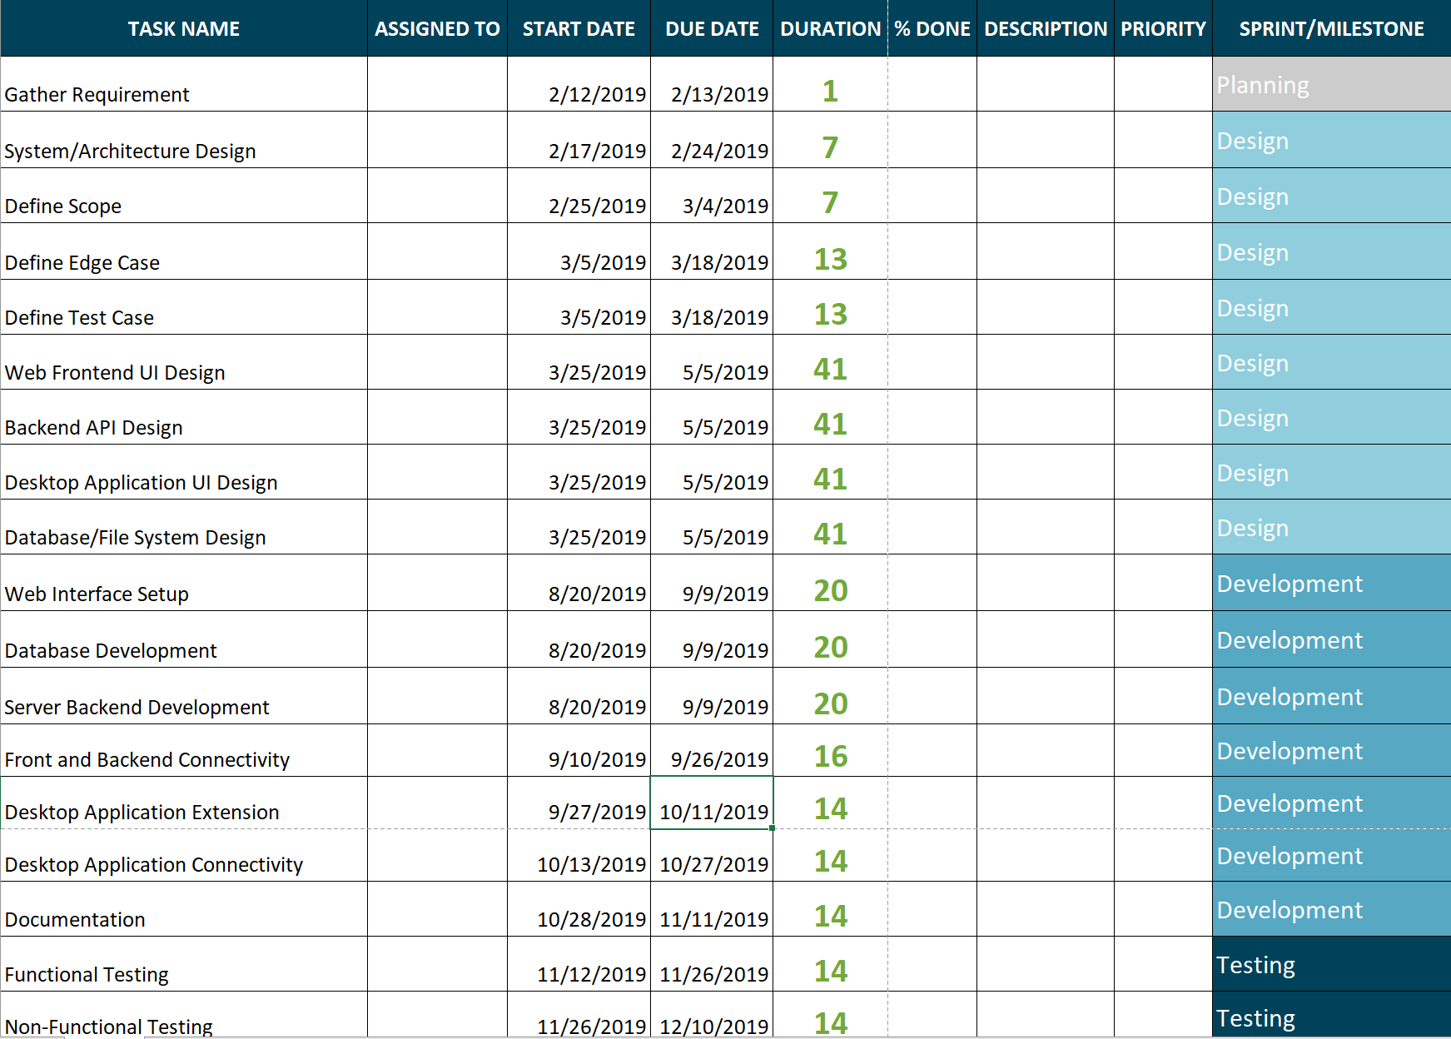
Project Plan
Project Milestones & Schedule
Notes:
Jason

Slide 11
System Design
Notes:
Luke

Slide 12
System Design
Functional Decomposition
User signs into web application
User can view/download/upload files
User can access the same information on the desktop application
Notes:
Chris

Slide 13
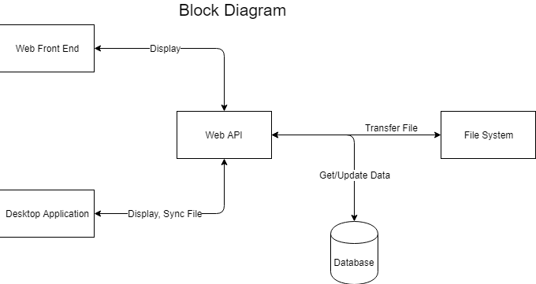
System Design
Detailed Design – Functional Modules Design
Notes:
Jason

Slide 14
System Design
Detailed Design – Interface Definition
User Interface:
Web page that is built on React.js
Communication Interface:
Http Post/Get Request
Notes:
Brian

Slide 15
System Design
Detailed Design – User Interfaces
Home Page
Composed of many React components
Profile Page
Basic Info
Admin Panel
Able to create new code for new user
Disable user account
Set permission
Notes:
brian

Slide 16
System Design
Software Platforms
React for web UI
C# for backend services and web API
Microsoft SQL Server as database.
Notes:
Jason

Slide 17
System Design
Test Plan
Unit Testing: Jest, Postman
Integration Testing: Jest
System Testing: Jest
Acceptance Testing: Buildertrend feedback
Compatibility Testing
Performance Testing
Notes:
Chris

Slide 18
System Design
Prototype Implementations
http://sddec19-11.sd.ece.iastate.edu/resource/Demo.mp4
Notes:
Jason

Slide 19
Conclusion
Project Status
Basic functional requirement satisfied
Database setup
Most designs are complete (Web UI, API, Database).
Notes:
Jason

Slide 20
Conclusion
Task Responsibility/Contributions
Christopher Bui
Developer, Meeting scribe
Brian Chodur
Front-end developer, UI Designer.
Luke Stoll
Report & Task Manager, Backend Developer
Zhenyu Zhao
Project Planner, Developer
Notes:
Chris

Slide 21
Conclusion
Next Semester Plan
Expand the current API to meet all functional requirement.
Extent desktop application to stay to sync with web application.
Finish create the frontend components.
Notes:
Jason

Slide 22
Questions
Notes:
Luke

